Slide 1
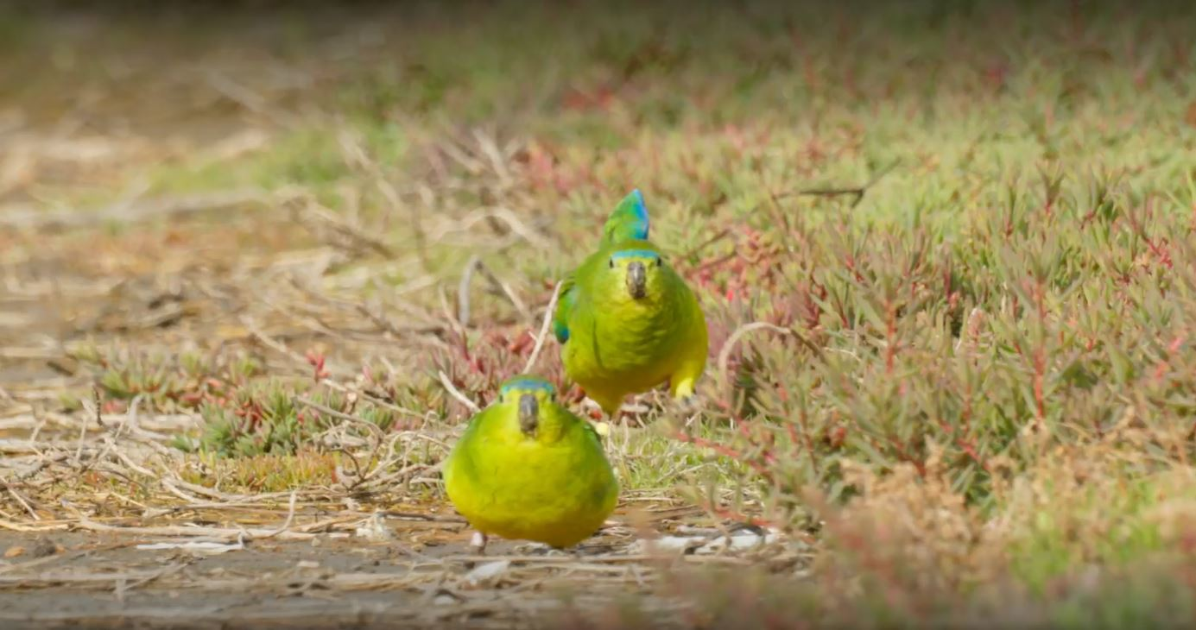
Make Conclusions

Slide 2
Learning intentions
  For students to
Consolidate and share their understanding of the issue
Make connections between topics

Slide 3

Socratic seminar
Use the Socratic Seminar PowerPoint presentation
WTP Socratic Seminar
WTP Virtual Tour resource

Slide 4
The End Product
In your groups, apply what you have learnt to design a social media campaign that aims to:
Rebrand recycled water. It needs a different name with positive and clean connotations.
Change the perception of recycled water by demonstrating that it is safe or by communicating a benefit of recycled water.
To do this you will need to produce a marketing plan for your social media campaign. Include the following in your proposal. WTP Social Media Campaign WTP Rubric Social Media Campaign
At the conclusion of each presentation, the rest of the class provides respectful and constructive peer feedback in the form of sentences that start with ‘I liked….’ and ‘ I wonder…’.

Slide 5
To create the social media campaign
To produce a marketing plan for your social media campaign. Include the following in your proposal. WTP Social Media Campaign WTP Rubric Social Media Campaign
Identify a target audience. Who are you trying to reach with your social media campaign? Campaigns are usually target at a specific segment of the population. Examples of target audiences could be parents, businesses, farmers, young people, gardeners or other groups you think of.
Demonstrate insight into your target audience. Describe their concerns and priorities. Include research that was used to inform your understanding of your audience.
Select and justify a strategy to reach your audience. Which social media platform will you use and why?
Create a tagline and a new name for recycled water. A tagline is a slogan that sums up your message in an interesting and concise way.
Produce a sample product and present it to the class. This can be done as a presentation or gallery walk.

